Slide 1

Autonomous Bumper Cars
Brian Bauer
David Kalbfleisch
Iman Ismail

Slide 2
Basic Goal
The bumper car arena shall be rectangular with rounded corners to prevent cars from getting stuck, and the arena shall contain 2 or more bumper cars that start at random locations and headings. Each game lasts for a predetermined length of time. The arena shall contain various obstacles (polls, boxes, etc.) to make the game more interesting.

Slide 3
All cars are a team of one. Each car attempts to maximize its score, and the car with the highest score wins.
At any moment, a given car is in the "attack" state or the "defend" state. (TODO - Criteria for selecting state?)
attack - The car drives directly towards its target. (TODO - What if the target goes behind an obstacle?)
defend - The car drives 45 degrees to either side of the ray cast from the attacker through the defender. This maximizes the rate of change of distance.

Slide 4
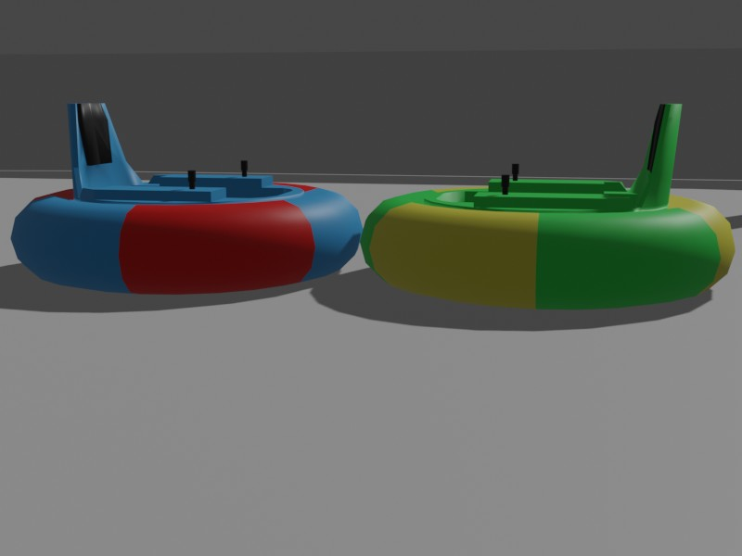
Training dataset

Slide 5
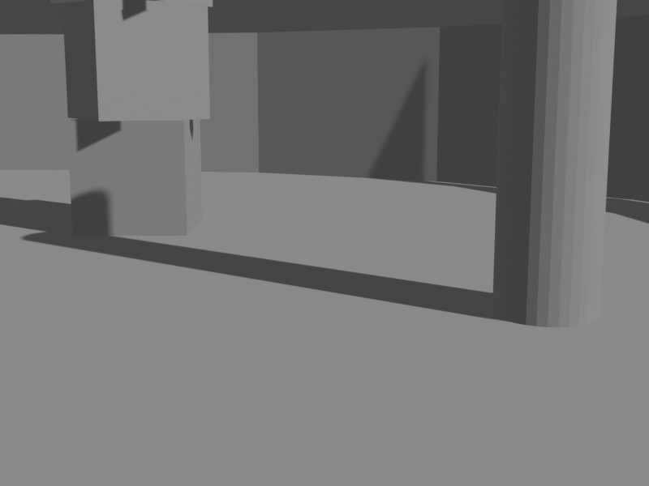

Slide 6
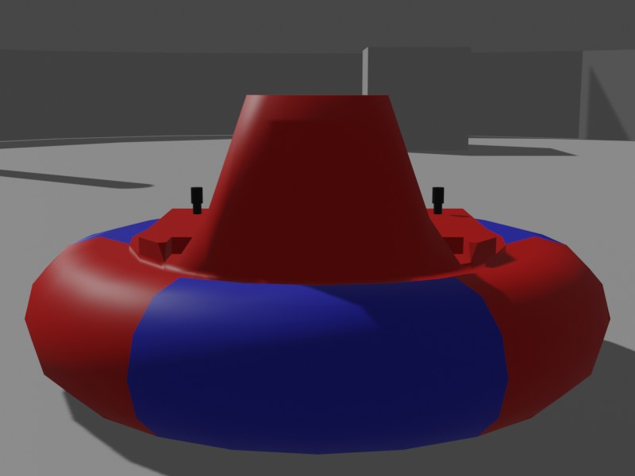

Slide 7
Machine Learning Model (CNN)
Classification:
Class 1 (it is ok to drive)
( This class will have images with no carts and no obstacles with the same environment)
Class 2 ( the car should go to the defend or the attack model)
This class will have images for obstacles and carts.

Slide 8
Timetable
5 March 2021: 3D arena is created
27 March 2021: car models created for the training set
8 April 2021: CNN Machine learning model will be created., and Robots can identify other vehicles and plot course to avoid all other vehicles
15 April 2021: Robots can predict movement of other vehicles and incorporate expected movement into avoidance plan
19 April 2021: Some of the robots may be deployed with the desire to hit other vehicles
3 May 2021: Presentation of results

